Slide 1
Electrical Circuits
EEE-281 Lecture Notes
Dr. Özçel Cangül
Lecture Notes by Dr. Ali Muhtaroğlu
Fall 2023
METU Northern Cyprus Campus
References:
Electric Circuits 10th Ed. by Nilsson & Riedel
Electrical Circuit Analysis 3rd Ed. by Johnson, Johnson, Hilburn, and Scott
Engineering Circuit Analysis 7th Ed. by Hayt, Kemmerly, and Durbin
Fundamentals of Electric Circuits 3rd Ed. by Alexander, and Sadiku

Slide 2
Circuit Analysis Techniques
Weeks 6-9
Reading: Nilsson & Riedel Chapter 4
Ali Muhtaroğlu

Slide 3
Analysis Methods
Will develop systematic ways of solving any linear circuit completely.
Linearity is assumed to reduce complexity of the methods
Source function of linear elements:
  When discussing dependent sources, we will assume sources of this nature as well
Also assume proportionality property:
Op-Amps in feedback mode will be linear.
The following type of terminal laws also obey linearity and proportionality:
Ali Muhtaroğlu

Slide 4
Thevenin and Norton Equivalents
Equivalent circuits with both resistors and sources
Thevenin Subcircuit
Norton Subcircuit
Ali Muhtaroğlu

Slide 5
Thevenin and Norton Equivalents
Equivalent circuits with both resistors and sources
Thevenin Subcircuit
Norton Subcircuit
KVL:
KCL:
Therefore Thevenin & Norton circuits are equivalent if R_{T} = R_{N} & v_{T} = R_{N}i_{N}
These are also referred to as source transformation equations.
Nomenclature:
v_{T} : Thevenin equivalent voltage source
R_{T} : Thevenin equivalent resistance
i_{N} : Norton equivalent current source
R_{N} : Norton equivalent resistance
Ali Muhtaroğlu

Slide 6
Example (N & R Problem 4.59a)
Use a series of source transformations to find the current i₀ in the circuit:
1 kΩ
4 mA
2 mA
3 kΩ
2 kΩ
Ali Muhtaroğlu

Slide 7
Example (N & R Problem 4.59a)
Use a series of source transformations to find the current i₀ in the circuit:
1 kΩ
4 mA
2 mA
3 kΩ
2 kΩ
Solution:
Source transformation:
R_{T} = R_{N} & v_{T} = R_{N}i_{N} (watch the assumed signs here !)
3 kΩ
1 kΩ
2 kΩ
12 V
-4 V
Ali Muhtaroğlu

Slide 8
Example (N & R Problem 4.59a)
Use a series of source transformations to find the current i₀ in the circuit:
1 kΩ
4 mA
2 mA
3 kΩ
2 kΩ
Solution:
Source transformation:
R_{T} = R_{N} & v_{T} = R_{N}i_{N} (watch the assumed signs here !)
3 kΩ
1 kΩ
2 kΩ
12 V
-4 V
12 V
-4 V
Ali Muhtaroğlu

Slide 9
Example (N & R Problem 4.59a)
Use a series of source transformations to find the current i₀ in the circuit:
1 kΩ
4 mA
2 mA
3 kΩ
2 kΩ
Solution:
Source transformation:
R_{T} = R_{N} & v_{T} = R_{N}i_{N} (watch the assumed signs here !)
3 kΩ
1 kΩ
2 kΩ
12 V
-4 V
Using Ohm’s Law:
i₀ = -16 V / 6 kΩ = -2.67 mA
12 V
-4 V
16 V
Ali Muhtaroğlu

Slide 10
Deriving Thevenin & Norton Equivalent Circuits:
If the circuit terminal law is extracted as a linear equation, then R_{T} & v_{T} are slope and intercept respectively.
i
+
Thevenin parameters
v = f(i)
-
Norton parameters
Ali Muhtaroğlu

Slide 11
Deriving Thevenin & Norton Equivalent Circuits:
If the circuit terminal law is extracted as a linear equation, then R_{T} & v_{T} are slope and intercept respectively.
i
+
Thevenin parameters
v = f(i)
-
Norton parameters
It follows that:
i.e. one could open-circuit the terminals to find v_{T}
Ali Muhtaroğlu

Slide 12
Deriving Thevenin & Norton Equivalent Circuits:
If the circuit terminal law is extracted as a linear equation, then R_{T} & v_{T} are slope and intercept respectively.
i
+
Thevenin parameters
v = f(i)
-
Norton parameters
It follows that:
i.e. one could open-circuit the terminals to find v_{T}
It also follows that:
i.e. one could short-circuit the terminals to find i_{N} , and R_{T} once v_{oc} is known
Ali Muhtaroğlu

Slide 13
Thevenin and Norton Equivalent Derivation:
Thevenin and Norton equivalent circuits can be obtained by applying any 2 of the following 3 steps (1-3). [Applying all 3 is not necessary.]
Ali Muhtaroğlu

Slide 14
Thevenin and Norton Equivalent Derivation:
Thevenin and Norton equivalent circuits can be obtained by applying any 2 of the following 3 steps (1-3). [Applying all 3 is not necessary.]
Open-circuit the terminals and calculate the open circuit voltage v_{oc}
Ali Muhtaroğlu

Slide 15
Thevenin and Norton Equivalent Derivation:
Thevenin and Norton equivalent circuits can be obtained by applying any 2 of the following 3 steps (1-3). [Applying all 3 is not necessary.]
Open-circuit the terminals and calculate the open circuit voltage v_{oc}
Short-circuit the terminals and calculate the short circuit current i_{sc}
Ali Muhtaroğlu

Slide 16
Thevenin and Norton Equivalent Derivation:
Thevenin and Norton equivalent circuits can be obtained by applying any 2 of the following 3 steps (1-3). [Applying all 3 is not necessary.]
Open-circuit the terminals and calculate the open circuit voltage v_{oc}
Short-circuit the terminals and calculate the short circuit current i_{sc}
Thevenin equivalent may then be found from:
and Norton equivalent may be found from:
Ali Muhtaroğlu

Slide 17
Thevenin and Norton Equivalent Derivation:
Thevenin and Norton equivalent circuits can be obtained by applying any 2 of the following 3 steps (1-3). [Applying all 3 is not necessary.]
Open-circuit the terminals and calculate the open circuit voltage v_{oc}
Short-circuit the terminals and calculate the short circuit current i_{sc}
Thevenin equivalent may then be found from:
and Norton equivalent may be found from:
A) Alternatively, equivalent Thevenin resistance, R_{T}, and Norton resistance, R_{N}, can be computed as the resistance looking into the terminals of the circuit when all internal sources have been killed (shut-down). In this state, independent voltage sources are replaced by short circuits, and independent current sources with open circuits. This method can only be used when there are no dependent sources in the circuit.
Ali Muhtaroğlu

Slide 18
Thevenin and Norton Equivalent Derivation:
Thevenin and Norton equivalent circuits can be obtained by applying any 2 of the following 3 steps (1-3). [Applying all 3 is not necessary.]
Open-circuit the terminals and calculate the open circuit voltage v_{oc}
Short-circuit the terminals and calculate the short circuit current i_{sc}
Thevenin equivalent may then be found from:
and Norton equivalent may be found from:
B) When there are dependent sources in the circuit, enhance the previous method (3A) by a test-like procedure. First deactivate all independent sources (do not deactivate dependent sources). Then apply a test voltage v_{T} and a test current i_{T} to the terminals of interest. Solve the circuit find the ratio between the two test parameters to get the effective resistance.
Ali Muhtaroğlu

Slide 19
Example 1
Find Thevenin and Norton equivalents:
Ali Muhtaroğlu

Slide 20
Example 1
Find Thevenin and Norton equivalents:
(Note: Since not specified, assume want the equivalent of the circuit to the right of the open terminals.)
Solution Step 1 :
1. Open-circuit the terminals (i=0):
Ali Muhtaroğlu

Slide 21
Example 1
Find Thevenin and Norton equivalents:
(Note: Since not specified, assume want the equivalent of the circuit to the right of the open terminals.)
Solution Step 2 :
1. Open-circuit the terminals (i=0):
2. Short-circuit the terminals (v=0):
Ali Muhtaroğlu

Slide 22
Example 1
Find Thevenin and Norton equivalents:
(Note: Since not specified, assume want the equivalent of the circuit to the right of the open terminals.)
Thus, equivalent circuits are:
Thevenin Equivalent Circuit:
Norton Equivalent Circuit:
Ali Muhtaroğlu

Slide 23
Example 2 (Johnson & Johnson Exercise 2.6 – Page 54)
Find the Thevenin equivalent of circuits to the right of line c-d, to the left of line a-b, and use the results to find the value of v₁ :
Ali Muhtaroğlu

Slide 24
Example 2 (Johnson & Johnson Exercise 2.6 – Page 54)
Find the Thevenin equivalent of circuits to the right of line c-d, to the left of line a-b, and use the results to find the value of v₁ :
Thevenin equivalent to the right of c-d:
1. Kill sources:
Ali Muhtaroğlu

Slide 25
Example 2 (Johnson & Johnson Exercise 2.6 – Page 54)
Find the Thevenin equivalent of circuits to the right of line c-d, to the left of line a-b, and use the results to find the value of v₁ :
Thevenin equivalent to the right of c-d:
1. Kill sources:
Ali Muhtaroğlu

Slide 26
Example 2 (Johnson & Johnson Exercise 2.6 – Page 54)
Find the Thevenin equivalent of circuits to the right of line c-d, to the left of line a-b, and use the results to find the value of v₁ :
Thevenin equivalent to the right of c-d:
1. Kill sources:
Ali Muhtaroğlu

Slide 27
Example 2 (Johnson & Johnson Exercise 2.6 – Page 54)
Find the Thevenin equivalent of circuits to the right of line c-d, to the left of line a-b, and use the results to find the value of v₁ :
Thevenin equivalent to the right of c-d:
1. Kill sources:
2. Open-circuit terminals (c-d):
Ali Muhtaroğlu

Slide 28
Example 2 (Johnson & Johnson Exercise 2.6 – Page 54)
Find the Thevenin equivalent of circuits to the right of line c-d, to the left of line a-b, and use the results to find the value of v₁ :
Thevenin equivalent to the left of a-b:
1. Kill sources:
Ali Muhtaroğlu

Slide 29
Example 2 (Johnson & Johnson Exercise 2.6 – Page 54)
Find the Thevenin equivalent of circuits to the right of line c-d, to the left of line a-b, and use the results to find the value of v₁ :
Thevenin equivalent to the left of a-b:
1. Kill sources:
2. Open-circuit terminals (a-b):
Ali Muhtaroğlu

Slide 30
Example 2 (Johnson & Johnson Exercise 2.6 – Page 54)
Find the Thevenin equivalent of circuits to the right of line c-d, to the left of line a-b, and use the results to find the value of v₁ :
Use the two equivalent circuits to reduce the circuit and find v₁:
Voltage division:
Note the negative sign comes from
the direction of the v₁ voltage as defined
in the problem.
Ali Muhtaroğlu

Slide 31
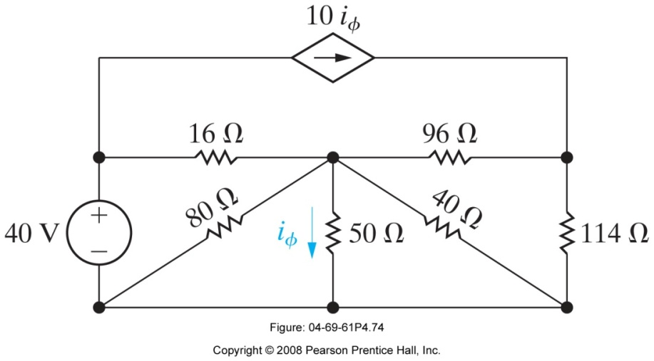
Example 3 (Based on N & R Problem 4.74)
When an ammeter is used to measure the current i_{ϕ} in the circuit shown below, it reads 10 A.
What is the resistance of the ammeter?
What is the percentage of error in the current measurement?
144 Ω
Ali Muhtaroğlu

Slide 32
Example 3 (Based on N & R Problem 4.74)
When an ammeter is used to measure the current i_{ϕ} in the circuit shown below, it reads 10 A.
What is the resistance of the ammeter?
What is the percentage of error in the current measurement?
Solution:
Note the ammeter needs to be placed in series with the 50Ω resistor if it is to measure i_{ϕ}.
First, let’s simplify the circuit connected to the terminals of the 50Ω resistor to a Thevenin equivalent.
144 Ω
Ali Muhtaroğlu

Slide 33
Example 3 (Based on N & R Problem 4.74)
When an ammeter is used to measure the current i_{ϕ} in the circuit shown below, it reads 10 A.
What is the resistance of the ammeter?
What is the percentage of error in the current measurement?
Solution:
Note the ammeter needs to be placed in series with the 50Ω resistor if it is to measure i_{ϕ}.
First, let’s simplify the circuit connected to the terminals of the 50Ω resistor to a Thevenin equivalent.
144 Ω
1. Open-circuit @ the 50Ω terminals (i_{ϕ} =0):
Ali Muhtaroğlu

Slide 34
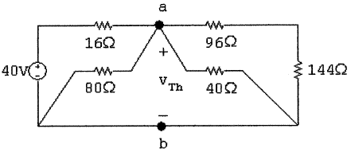

Example 3 (Based on N & R Problem 4.74)
When an ammeter is used to measure the current i_{ϕ} in the circuit shown below, it reads 10 A.
What is the resistance of the ammeter?
What is the percentage of error in the current measurement?
Solution:
Note the ammeter needs to be placed in series with the 50Ω resistor if it is to measure i_{ϕ}.
First, let’s simplify the circuit connected to the terminals of the 50Ω resistor to a Thevenin equivalent.
144 Ω
1. Open-circuit @ the 50Ω terminals (i_{ϕ} =0):
Through KCL:
Ali Muhtaroğlu

Slide 35
Example 3 (Based on N & R Problem 4.74)
When an ammeter is used to measure the current i_{ϕ} in the circuit shown below, it reads 10 A.
What is the resistance of the ammeter?
What is the percentage of error in the current measurement?
Solution:
2. Short-circuit @ the 50Ω terminals (v_{ab}=0):
144 Ω
Ali Muhtaroğlu

Slide 36
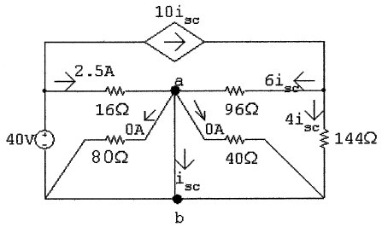

Example 3 (Based on N & R Problem 4.74)
When an ammeter is used to measure the current i_{ϕ} in the circuit shown below, it reads 10 A.
What is the resistance of the ammeter?
What is the percentage of error in the current measurement?
Solution:
2. Short-circuit @ the 50Ω terminals (v_{ab}=0):
144 Ω
The above currents can be calculated through Ohm’s Law and current division. Then,
Ali Muhtaroğlu

Slide 37
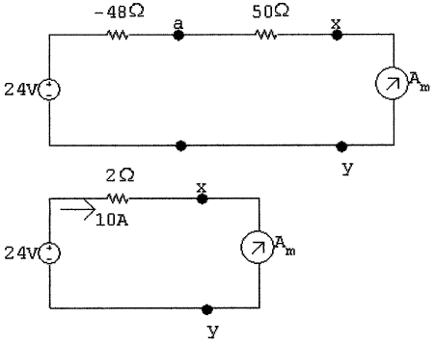
Example 3 (Based on N & R Problem 4.74)
When an ammeter is used to measure the current i_{ϕ} in the circuit shown below, it reads 10 A.
What is the resistance of the ammeter?
What is the percentage of error in the current measurement?
Solution:
2. Short-circuit @ the 50Ω terminals (v_{ab}=0):
144 Ω
3. Therefore the reduced circuit is:
The above currents can be calculated through Ohm’s Law and current division. Then,
Ali Muhtaroğlu

Slide 38
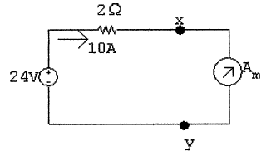


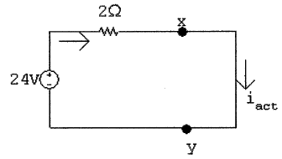
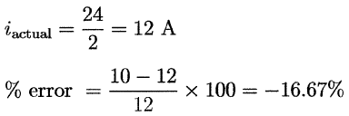
Example 3 (Based on N & R Problem 4.74)
When an ammeter is used to measure the current i_{ϕ} in the circuit shown below, it reads 10 A.
What is the resistance of the ammeter?
What is the percentage of error in the current measurement?
Solution:
Given the reduced circuit:
144 Ω
Since the ammeter measures i_{ϕ} =10 A:
Therefore,
b) Actual current (if ammeter was not connected in series):
Ali Muhtaroğlu

Slide 39
Example 3 (Based on N & R Problem 4.74)
When an ammeter is used to measure the current i_{ϕ} in the circuit shown below, it reads 10 A.
What is the resistance of the ammeter?
What is the percentage of error in the current measurement?
Question: How would we find R_{Th} through the Step 3(B) of the Thevenin/Norton derivation guidelines presented earlier?
144 Ω
Ali Muhtaroğlu

Slide 40
Example 3 (Based on N & R Problem 4.74)
When an ammeter is used to measure the current i_{ϕ} in the circuit shown below, it reads 10 A.
What is the resistance of the ammeter?
What is the percentage of error in the current measurement?
Question: How would we find R_{Th} through the Step 3(B) of the Thevenin/Norton derivation guidelines presented earlier?
- Kill independent sources, apply a test current i_{t}, and find R = v_{t}/i_{t}
144 Ω
redraw
Ali Muhtaroğlu

Slide 41
Example 3 (Based on N & R Problem 4.74)
When an ammeter is used to measure the current i_{ϕ} in the circuit shown below, it reads 10 A.
What is the resistance of the ammeter?
What is the percentage of error in the current measurement?
Question: How would we find R_{Th} through the Step 3(B) of the Thevenin/Norton derivation guidelines presented earlier?
- Kill independent sources, apply a test current i_{t}, and find R = v_{t}/i_{t}
144 Ω
Ali Muhtaroğlu

Slide 42
Theoretical Sources
An ideal voltage and current source can theoretically deliver infinite power:
Ali Muhtaroğlu

Slide 43
Practical Sources
In reality there are always resistive drops associated with practical voltage and current sources, which can be modeled using Thevenin & Norton equivalent circuits respectively.
Ali Muhtaroğlu

Slide 44
Example (2.7.3 Johnson & Johnson P:61)
An automobile battery in a poor state of charge has an open-circuit voltage of +11.5 V dc and when loaded by the starter motor, which we model as a 0.8-Ω resistor, supplies 10 V across the starter motor terminals. Determine the power delivered to the load and the power being dissipated internally in the source resistance under these conditions.
Ali Muhtaroğlu

Slide 45
Example (2.7.3 Johnson & Johnson P:61)
An automobile battery in a poor state of charge has an open-circuit voltage of +11.5 V dc and when loaded by the starter motor, which we model as a 0.8-Ω resistor, supplies 10 V across the starter motor terminals. Determine the power delivered to the load and the power being dissipated internally in the source resistance under these conditions.
Solution:
First draw out the circuit:
Voltage Division:
Ali Muhtaroğlu

Slide 46
Example 2 (2.7.2 Johnson & Johnson P:61)
A 500-mA fuse is located in the wire connecting a power supply to its load. If the power supply has an open-circuit voltage of +100 V dc and a source resistance of 30 Ω, what is the range of acceptable load resistances that will not cause the fuse to blow?
Ali Muhtaroğlu

Slide 47
Example 2 (2.7.2 Johnson & Johnson P:61)
A 500-mA fuse is located in the wire connecting a power supply to its load. If the power supply has an open-circuit voltage of +100 V dc and a source resistance of 30 Ω, what is the range of acceptable load resistances that will not cause the fuse to blow?
Solution:
First draw out the circuit:
Ali Muhtaroğlu

Slide 48
Superposition
Given a circuit with variables x_{i}’s (currents and voltages), linear scaling parameters a_{i}’s, and the net source value y_{a}, KCL or KVL will result in an equation of type :
Similarly, if another source y_{b} is applied to the circuit:
Note a_{i}’s are unchanged because the linear elements and the connection among them are unchanged.
If the two sources are applied together, then the response to the new circuit is the summation of the individual responses:
Principle of superposition: The overall response of a circuit containing several sources is the sum of the responses to each individual source with the other sources killed.
Ali Muhtaroğlu

Slide 49
Example : Based on 4.3 (Johnson & Johnson P:123)
Solve for the circuit variables i₁ and i₂ by applying the principle of superposition to the two sources.
Ali Muhtaroğlu

Slide 50
Example : Based on 4.3 (Johnson & Johnson P:123)
Solve for the circuit variables i₁ and i₂ by applying the principle of superposition to the two sources.
1. Kill the current source to solve for component a:
Ali Muhtaroğlu

Slide 51
Example : Based on 4.3 (Johnson & Johnson P:123)
Solve for the circuit variables i₁ and i₂ by applying the principle of superposition to the two sources.
1. Kill the current source to solve for component a:
2. Kill the voltage source to solve for component b:
Ali Muhtaroğlu

Slide 52
Example : Based on 4.3 (Johnson & Johnson P:123)
Solve for the circuit variables i₁ and i₂ by applying the principle of superposition to the two sources.
1. Kill the current source to solve for component a:
2. Kill the voltage source to solve for component b:
3. Apply the superposition principle (each response is sum of its components):
Ali Muhtaroğlu

Slide 53
Superposition
Dependent sources are NOT killed when using the superposition method for calculating circuit parameters.
Even in linear circuits power does not superpose since it is not a linear function of voltage and current. Power needs to be calculated last once all the components are summed.
Ali Muhtaroğlu

Slide 54
Example (4.5 Johnson & Johnson P:126)
Find the voltage v and the power dissipated by the 3 Ω resistor.
Ali Muhtaroğlu

Slide 55
Example (4.5 Johnson & Johnson P:126)
Find the voltage v and the power dissipated by the 3 Ω resistor.
1. Kill the current source to solve for component a:
KVL & Ohm’s Law:
Ohm’s Law:
Ali Muhtaroğlu

Slide 56
Example (4.5 Johnson & Johnson P:126)
Find the voltage v and the power dissipated by the 3 Ω resistor.
1. Kill the current source to solve for component a:
KVL & Ohm’s Law:
Ohm’s Law:
2. Kill the voltage source (independent source only!) to solve for component b:
KCL:
KVL & Ohm’s Law:
Ohm’s Law:
Ali Muhtaroğlu

Slide 57
Example (4.5 Johnson & Johnson P:126)
Find the voltage v and the power dissipated by the 3 Ω resistor.
1. Kill the current source to solve for component a:
KVL & Ohm’s Law:
Ohm’s Law:
2. Kill the voltage source (independent source only!) to solve for component b:
KCL:
KVL & Ohm’s Law:
Ohm’s Law:
3. By superposition of component voltages:
Ali Muhtaroğlu

Slide 58
Example (4.5 Johnson & Johnson P:126)
Find the voltage v and the power dissipated by the 3 Ω resistor.
1. Kill the current source to solve for component a:
KVL & Ohm’s Law:
Ohm’s Law:
2. Kill the voltage source (independent source only!) to solve for component b:
KCL:
KVL & Ohm’s Law:
Ohm’s Law:
3. By superposition of component voltages:
4. Power through the 3Ω resistor:
Ali Muhtaroğlu

Slide 59
Example (4.5 Johnson & Johnson P:126)
Find the voltage v and the power dissipated by the 3 Ω resistor.
1. Kill the current source to solve for component a:
KVL & Ohm’s Law:
Ohm’s Law:
2. Kill the voltage source (independent source only!) to solve for component b:
KCL:
KVL & Ohm’s Law:
Ohm’s Law:
3. By superposition of component voltages:
4. Power through the 3Ω resistor:
Note: Superposition of
component a and b powers
does not give the right answer
Ali Muhtaroğlu

Slide 60
Example (4.2.3 Johnson & Johnson P:127)
Find v and i₁ by superposition in the following circuit:
Ali Muhtaroğlu

Slide 61
Example (4.2.3 Johnson & Johnson P:127)
Find v and i₁ by superposition in the following circuit:
1. Kill the 1st voltage source (component a):
KVL :
KCL:
Ohm’s:
Using (1) & (2):
Using (3) & (4):
Ali Muhtaroğlu

Slide 62
Example (4.2.3 Johnson & Johnson P:127)
Find v and i₁ by superposition in the following circuit:
1. Kill the 1st voltage source (component a):
KVL :
KCL:
Ohm’s:
Using (1) & (2):
Using (3) & (4):
2. Kill the 2nd voltage source (component b):
KVL :
KCL :
. From above: so,
Ali Muhtaroğlu

Slide 63
Example (4.2.3 Johnson & Johnson P:127)
Find v and i₁ by superposition in the following circuit:
1. Kill the 1st voltage source (component a):
KVL :
KCL:
Ohm’s:
Using (1) & (2):
Using (3) & (4):
2. Kill the 2nd voltage source (component b):
KVL :
KCL :
. From above: so,
3. By superposition of components:
Ali Muhtaroğlu

Slide 64
Nodal Analysis
Select a reference node and define the voltage at each of the nonreference nodes with respect to the reference node. Call this the node voltage.
In nodal analysis method, analyze the node voltages first, and derive the other circuit variables (currents and voltages) next.
Many circuit elements are connected to a reference plane that is a metallic base or chasis. Usually the chasis or reference plane is shorted to the earth itself. We call this node the ground node or the ground or the reference node.
Ohm’s Law:
The current from Node 1 to Node 2 through a resistor is the difference in node voltages divided by the resistance R, or multiplied by the conductance G.
Ali Muhtaroğlu

Slide 65
Circuits with Current Sources & Resistances
KCL at Node 1:
In terms of node voltages:
KCL at Node 2:
-ve conductance
Connecting node 1 & node 2
Rearranging:
sum of conductances
connected to node 1
current entering node 1
current entering node 2
-ve conductance
Connecting node 1 & node 2
sum of conductances
connected to node 2
Ali Muhtaroğlu

Slide 66
Example
Solve for node voltage and i in the following circuit:
Ali Muhtaroğlu

Slide 67
Example
Solve for node voltage and i in the following circuit:
Ali Muhtaroğlu

Slide 68
Example
Solve for node voltage and i in the following circuit:
Node 1:
Ali Muhtaroğlu

Slide 69
Example
Solve for node voltage and i in the following circuit:
Node 1:
Node 2:
Ali Muhtaroğlu

Slide 70
Example
Solve for node voltage and i in the following circuit:
Node 1:
Node 2:
Node 3:
Ali Muhtaroğlu

Slide 71
Example
Solve for node voltage and i in the following circuit:
Node 1:
Node 2:
Node 3:
3 simultaneous equations w/ 3 unknowns can be solved using few different
methods. The methods are covered in the appendix of the Johnson & Johnson text . One method involves using matrices as below (Cramer’s rule.)
Ali Muhtaroğlu

Slide 72
Example
Solve for node voltage and i in the following circuit:
Node 1:
Node 2:
Node 3:
3 simultaneous equations w/ 3 unknowns can be solved using few different
methods. The methods are covered in the appendix of the Johnson & Johnson text. One method involves using matrices as below (Cramer’s rule.)
a) First find determinant, Δ, of the coefficient matrix:
v₁
v₂
v₃
Ali Muhtaroğlu

Slide 73
Example
Solve for node voltage and i in the following circuit:
Node 1:
Node 2:
Node 3:
3 simultaneous equations w/ 3 unknowns can be solved using few different
methods. The methods are covered in the appendix of the Johnson & Johnson text. One method involves using matrices as below (Cramer’s rule.)
a) First find determinant, Δ, of the coefficient matrix:
v₁
v₂
v₃
b) Find individual voltages by plugging in the right hand values to respective columns:
Ali Muhtaroğlu

Slide 74
Example
Solve for node voltage and i in the following circuit:
Node 1:
Node 2:
Node 3:
3 simultaneous equations w/ 3 unknowns can be solved using few different
methods. The methods are covered in the appendix of the Johnson & Johnson text. One method involves using matrices as below (Cramer’s rule.)
a) First find determinant, Δ, of the coefficient matrix:
v₁
v₂
v₃
b) Find individual voltages by plugging in the right hand values to respective columns:
Find other variables:
Ali Muhtaroğlu

Slide 75
Example
Ali Muhtaroğlu

Slide 76
Example
Label reference and non-reference nodes and solve.
Ali Muhtaroğlu

Slide 77
Example
Label reference and non-reference nodes and solve.
Node 1:
Node 2:
In addition:
Substituting for i and v into (1) and (2):
Solving the simultaneous equations:
Ali Muhtaroğlu

Slide 78
Circuits with Voltage Sources (Supernodes)
The presence of voltage sources reduces the number of equations and the number of unknowns in nodal analysis by one per voltage source through supernodes.
Ali Muhtaroğlu

Slide 79
Circuits with Voltage Sources (Supernodes)
The presence of voltage sources reduces the number of equations and the number of unknowns in nodal analysis by one per voltage source through supernodes.
Example:
4 S
Ali Muhtaroğlu

Slide 80
Circuits with Voltage Sources (Supernodes)
The presence of voltage sources reduces the number of equations and the number of unknowns in nodal analysis by one per voltage source through supernodes.
Example:
4 S
Identify all nodes
Ali Muhtaroğlu

Slide 81
Circuits with Voltage Sources (Supernodes)
The presence of voltage sources reduces the number of equations and the number of unknowns in nodal analysis by one per voltage source through supernodes.
Example:
Supernode B
4 S
Identify supernodes
Supernode A
Ali Muhtaroğlu

Slide 82
Circuits with Voltage Sources (Supernodes)
The presence of voltage sources reduces the number of equations and the number of unknowns in nodal analysis by one per voltage source through supernodes.
Example:
Supernode B
Do KCL on all nodes (nodes 2,3) and
supernodes (supernode B) except
the supernodes containing the reference
node (supernode A).
4 S
Node 2:
Node 3:
Supernode B:
Supernode A
Left with 3 equations and 3 unknowns, so this can be solved
Easily.
Ali Muhtaroğlu

Slide 83
Summary of Nodal Analysis Procedure
Designate a reference node (preferably with the greatest number of branches.)
Label N-1 nodes to analyze
If voltage sources exist, form supernodes (or recognize relationship between nodes separated by voltage sources)
KCL (in terms of node voltages) per each nonreference node and each supernode that does not contain the reference node.
Relate voltages across voltage sources and all other unknown variables to the node voltages.
Ali Muhtaroğlu

Slide 84
Example
i
Ali Muhtaroğlu

Slide 85
Example
i
Step 1: Designate reference node
Ali Muhtaroğlu

Slide 86
Example
i
Step 2: Label N-1 nodes to analyze
Ali Muhtaroğlu

Slide 87
Example
i
Step 3: If voltage sources exist, form Supernodes.
Ali Muhtaroğlu

Slide 88
Example
i
Step 4: KCL (in terms of node voltages) per each nonreference node and each supernode that does not contain the reference node.
Node 1:
Node 2:
3 unknowns & 2 equations; need one more equation
Ali Muhtaroğlu

Slide 89
Example
i
Step 4: KCL (in terms of node voltages) per each nonreference node and each supernode that does not contain the reference node.
Step 5: Relate voltages across voltage sources and all other unknown variables to the node voltages.
Node 1:
Node 2:
3 unknowns & 2 equations; need one more equation:
Solve:
Ali Muhtaroğlu

Slide 90
Mesh Analysis
Apply KVL around loops in the circuit to solve for currents first.
Note: Nodal analysis is applicable to general circuits with nonplanar structure. Mesh analysis only applies to planar circuits (no branch crosses another.)
mesh
A mesh is a loop that contains
no elements within it.
[ A supermesh is an exception as will be covered later.]
Ali Muhtaroğlu

Slide 91
Mesh Current
2 independent equations and 2 unknowns can be solved easily:
If the circuit has M meshes, then need M independent equations to solve for M mesh currents.
1. Apply KVL to the left hand mesh:
2. Apply KVL to the right hand mesh:
Ali Muhtaroğlu

Slide 92
Example
Use mesh analysis to determine the three mesh currents in the following circuit:
Ali Muhtaroğlu

Slide 93
Example
Use mesh analysis to determine the three mesh currents in the following circuit:
Mesh 1:
Ali Muhtaroğlu

Slide 94
Example
Use mesh analysis to determine the three mesh currents in the following circuit:
Mesh 1:
Mesh 2:
Ali Muhtaroğlu

Slide 95
Example
Use mesh analysis to determine the three mesh currents in the following circuit:
Mesh 1:
Mesh 2:
Mesh 3:
Solving 3 equations with 3 unknowns, get:
Ali Muhtaroğlu

Slide 96
Example w/ a dependent source
Mesh 1 (right-hand side):
Mesh 2 (left-hand side):
Ali Muhtaroğlu

Slide 97
Example w/ a dependent source
Mesh 1 (right-hand side):
Mesh 2 (left-hand side):
2 equations, 3 unknowns; need 1 more equation:
Ali Muhtaroğlu

Slide 98
Example w/ a dependent source
Mesh 1 (right-hand side):
Mesh 2 (left-hand side):
2 equations, 3 unknowns; need 1 more equation:
Substitute for v_{x} into (2):
From (1):
Ali Muhtaroğlu

Slide 99
Supermesh
Create a supermesh from two meshes that have a current source as a common element. This reduces the number of meshes by one for each current source. If the current source is in the perimeter of the circuit, then the mesh in which it is located is ignored.
Ali Muhtaroğlu

Slide 100
Supermesh
Create a supermesh from two meshes that have a current source as a common element. This reduces the number of meshes by one for each current source. If the current source is in the perimeter of the circuit, then the mesh in which it is located is ignored.
Example:
Ali Muhtaroğlu

Slide 101
Supermesh
Create a supermesh from two meshes that have a current source as a common element. This reduces the number of meshes by one for each current source. If the current source is in the perimeter of the circuit, then the mesh in which it is located is ignored.
Example:
Combine mesh 1 and 3 since there is a current source at their common boundary:
Mesh 1+3:
Supermesh
Ali Muhtaroğlu

Slide 102
Supermesh
Create a supermesh from two meshes that have a current source as a common element. This reduces the number of meshes by one for each current source. If the current source is in the perimeter of the circuit, then the mesh in which it is located is ignored.
Example:
Combine mesh 1 and 3 since there is a current source at their common boundary:
Mesh 1+3:
Mesh 2:
Supermesh
Ali Muhtaroğlu

Slide 103
Supermesh
Create a supermesh from two meshes that have a current source as a common element. This reduces the number of meshes by one for each current source. If the current source is in the perimeter of the circuit, then the mesh in which it is located is ignored.
Example:
Combine mesh 1 and 3 since there is a current source at their common boundary:
Mesh 1+3:
Mesh 2:
Supermesh
2 equantions, 3 unknowns; add an equation for the
independent source:
Ali Muhtaroğlu

Slide 104
Supermesh
Create a supermesh from two meshes that have a current source as a common element. This reduces the number of meshes by one for each current source. If the current source is in the perimeter of the circuit, then the mesh in which it is located is ignored.
Example:
Combine mesh 1 and 3 since there is a current source at their common boundary:
Mesh 1+3:
Mesh 2:
Supermesh
2 equantions, 3 unknowns; add an equation for the
independent source:
Solving, get:
Ali Muhtaroğlu

Slide 105
Example
Use mesh analysis to determine the three mesh currents in the following circuit:
Ali Muhtaroğlu

Slide 106
Example
Use mesh analysis to determine the three mesh currents in the following circuit:
Since 15 A source is on the perimeter of the circuit, eliminate mesh 1 from the consideration: i₁ = 15 A
Since i₁ is known, can write an equation for the dependent source as:
& Ohm’s Law:
These equations lead to:
Then, KVL @ Mesh 2:
Solving (1) and (2), get:
Ali Muhtaroğlu

Slide 107
Summary of Mesh Analysis Procedure
Label M mesh currents (for M meshes) – clockwise convention
If the circuit has current sources shared by two meshes, form a supermesh
Write KVL per mesh except if a current source is in the periphery of the mesh
Relate current sources to the mesh currents through KCL
Express all other unknown variables in terms of the mesh currents
Ali Muhtaroğlu

Slide 108
Example
Find i using mesh analysis:
Ali Muhtaroğlu

Slide 109
Example
Find i using mesh analysis:
Label 3 mesh currents (for 3 meshes) – clockwise convention
Ali Muhtaroğlu

Slide 110
Example
Find i using mesh analysis:
Label 3 mesh currents (for 3 meshes) – clockwise convention
If the circuit has current sources shared by two meshes, form a supermesh
(none in this case)
Ali Muhtaroğlu

Slide 111
Example
Find i using mesh analysis:
Label 3 mesh currents (for 3 meshes) – clockwise convention
If the circuit has current sources shared by two meshes, form a supermesh
(none in this case)
Write KVL per mesh except if a current source is in the periphery of the mesh
KVL @ Mesh 2 (Mesh 1 and 3 have current sources at the periphery) :
Ali Muhtaroğlu

Slide 112
Example
Find i using mesh analysis:
Label 3 mesh currents (for 3 meshes) – clockwise convention
If the circuit has current sources shared by two meshes, form a supermesh
(none in this case)
Write KVL per mesh except if a current source is in the periphery of the mesh
KVL @ Mesh 2 (Mesh 1 and 3 have current sources at the periphery) :
Relate current sources to the mesh currents through KCL:
Ali Muhtaroğlu

Slide 113
Example
Find i using mesh analysis:
Label 3 mesh currents (for 3 meshes) – clockwise convention
If the circuit has current sources shared by two meshes, form a supermesh
(none in this case)
Write KVL per mesh except if a current source is in the periphery of the mesh
KVL @ Mesh 2 (Mesh 1 and 3 have current sources at the periphery) :
Relate current sources to the mesh currents through KCL:
Express all other unknown variables in terms of the mesh currents
(Not applicable in this case.)
Ali Muhtaroğlu

Slide 114
Example
Apply mesh analysis to the following circuit:
Ali Muhtaroğlu

Slide 115
Example
Apply mesh analysis to the following circuit:
KVL around Supermesh 1+3+4:
Ali Muhtaroğlu

Slide 116
Example
Apply mesh analysis to the following circuit:
KVL around Supermesh 1+3+4:
KVL around Mesh 2:
Ali Muhtaroğlu

Slide 117
Example
Apply mesh analysis to the following circuit:
KVL around Supermesh 1+3+4:
KVL around Mesh 2:
In addition the following relationships can be extracted from the circuit:
Ali Muhtaroğlu

Slide 118
Example
Apply mesh analysis to the following circuit:
KVL around Supermesh 1+3+4:
KVL around Mesh 2:
In addition the following relationships can be extracted from the circuit:
– (5) represent 5 simultaneous equations with 5 unknowns; therefore, the parameters of interest can be calculated as:
Ali Muhtaroğlu

Slide 119
Maximum Power Transfer
Maximizing the amount of power transferred from a power source to a load is important, and is a major focus area in system design. The power not transferred to the load for useful work is “wasted”:
- Typically the wasted power goes to generating heat, in which case system cost may increase due to the addition of a cooling solution
- In mobile systems, battery gets depleted faster if excessive power is wasted
- In communications, the load needs to receive some minimum amount of power before the link is healthy (voice/image quality)
- In power utility systems, the electric power lost in generation, transmission, and distribution becomes very significant if efficiency is low due to large amounts of power
Ali Muhtaroğlu

Slide 120
Maximizing Power Transfer
Assume the below model, where the Thevenin voltage source and the resistor on the left is the equivalent of a more complex circuit delivering power to a resistive load represented by R_{L}. How should we design the load (R_{L}=?) in order to maximize the power delivered to it?
To find the R_{L} that gives the maximum power:
To confirm R_{L}=R_{Th} corresponds to a maximum:
Ali Muhtaroğlu

Slide 121
Maximizing Power Transfer
Assume the below model, where the Thevenin voltage source and the resistor on the left is the equivalent of a more complex circuit delivering power to a resistive load represented by R_{L}. How should we design the load (R_{L}=?) in order to maximize the power delivered to it?
This is a significant result:
To maximize power delivery, the load resistance needs to be matched to the effective source resistance.
For maximum power delivery:
Ali Muhtaroğlu

Slide 122
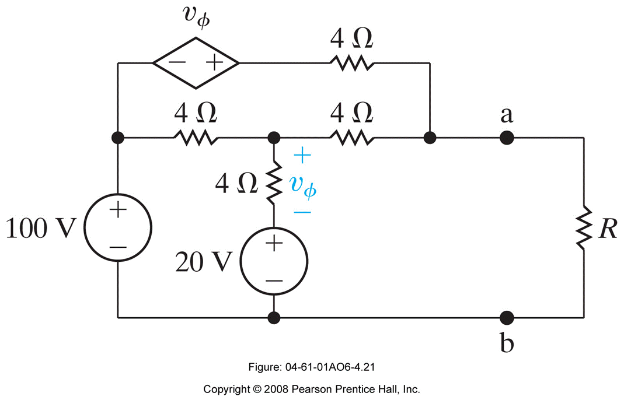
Example: N & R AP 4.21 & 4.22
Find the value of R that enables the circuit shown to deliver maximum power to the terminals a,b.
Find the maximum power delivered to R.
How much power is the 100 V source delivering to the network under maximum power delivery conditions?
Repeat (c) for the dependent voltage source.
What percentage of the total power generated by these two sources is delivered to the load resistor R?
Ali Muhtaroğlu

Slide 123
Example: N & R AP 4.21 & 4.22 - Solution
Find the value of R that enables the circuit shown to deliver maximum power to the terminals a,b.
First find the Thevenin equivalent of the circuit to the left of a-b.
Apply nodal analysis to find the v_{Th}=v_{oc}=v_{a} with a-b open-circuited:
KCL @ Node a:
KCL @ Node 1:
From (1) and (2):
1
Ali Muhtaroğlu

Slide 124
Example: N & R AP 4.21 & 4.22 - Solution
Find the value of R that enables the circuit shown to deliver maximum power to the terminals a,b.
First find the Thevenin equivalent of the circuit to the left of a-b.
Apply nodal analysis to find i_{sc}:
KCL @ Node 1:
KCL @ Node a:
1
i_{sc}
Ali Muhtaroğlu

Slide 125
Example: N & R AP 4.21 & 4.22 - Solution
Find the value of R that enables the circuit shown to deliver maximum power to the terminals a,b.
First find the Thevenin equivalent of the circuit to the left of a-b.
Therefore:
From (3) and (4): and
Equivalent circuit:
To maximize power:
Ali Muhtaroğlu

Slide 126
Example: N & R AP 4.21 & 4.22 - Solution
Find the value of R that enables the circuit shown to deliver maximum power to the terminals a,b.
Find the maximum power delivered to R.
First find the Thevenin equivalent of the circuit to the left of a-b.
Therefore:
From (3) and (4): and
Equivalent circuit:
To maximize power:
Maximum Power:
Ali Muhtaroğlu

Slide 127
Example: N & R AP 4.21 & 4.22 - Solution
How much power is the 100 V source delivering to the network under maximum power delivery conditions?
Apply nodal analysis to find i_{100V} (R=3Ω):
KCL @ Node 1:
KCL @ Node a:
From (5) and (6):
KCL @ Node 2:
1
2
i_{100V}
Ali Muhtaroğlu

Slide 128
Example: N & R AP 4.21 & 4.22 - Solution
Repeat (c) for the dependent voltage source.
What percentage of the total power generated by these two sources is delivered to the load resistor R?
1
2
i_{100V}
Ali Muhtaroğlu

